Slide 1

LPS-SHA1: Low Power and Simple Implementation of Secure Hashing Algorithm (SHA1)using VHDL Implemented on FPGA
Choi Tim Antony Yung, Laurice Sattouf, Dimitri Garcia, Mohamed El-Hadedy Department of Electrical and Computer Engineering College of Engineering, California Polytechnic State University, Pomona Pomona, California
Email: {choiyung, lsattouf, dimitrig, mealy}@cpp.edu

Slide 2
SHA1: Introduction
Hash Secure Algorithm (SHA1) is a cryptographic hash function which takes an input and produces a 160- bit hash value known as a message digest – typically rendered as a hexadecimal number, 40 digits long. It was designed by the untitled Sates National Security Agency.
Properties of SHA1: summarized in Table 1.
Algorithm | Message Size (bits) | Block Size (bits) | Word Size (bits) | Message Digest size (bits)
SHA1 | < 2⁶⁴ | 512 | 32 | 160
Table 1. Properties of secure Hash Function

Slide 3

Motivation and Target:
Although SHA1 is Broken Algorithm in Cryptography, but it is still used as part of other hash based cryptography schemes. Therefore, in this presentation:
SHA-1 hash function is explored in depth and various implementations that have been proposed in the international literature are considered.
A system is presented to feed message as byte stream from a computer via UART to a Digilent Nexys A7 development board and display resulting SHA1 digest by VGA output.
Design aspects of performance and power dissipation are considered to explore and compare current implementations.

Slide 4
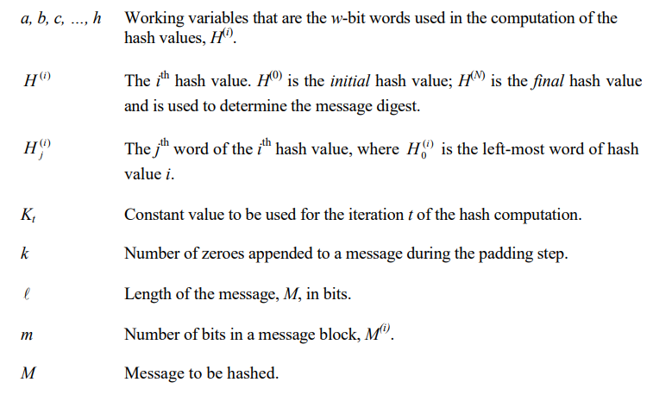
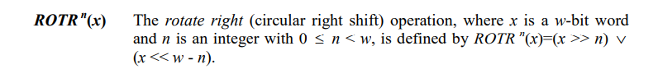
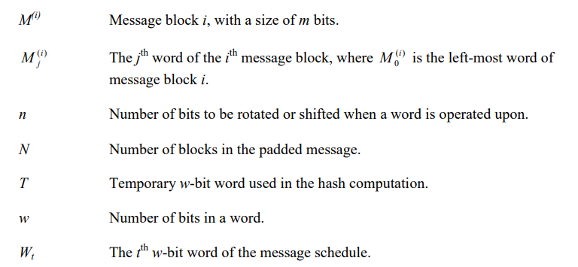
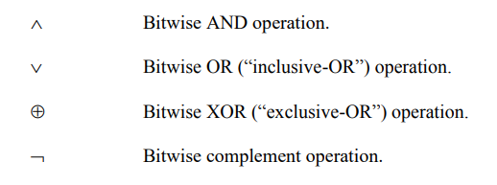
Parameters and Operations used in SHA1 Algorithm
Federal Information (nist.gov)

Slide 5
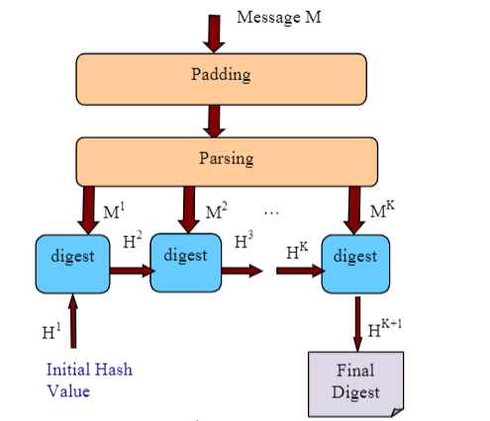
SHA1: Stages for SHA1 Algorithm
Preprocessing
Padding the Message M.
Parsing the message into message blocks.
Setting the initial hash values
Hash Computation
(PDF) Design of a proven correct SHA circuit (researchgate.net)
Figure1. SHA1 algorithm steps

Slide 6
Preprocessing
Includes three different steps:
Padding the message M:
M is concatenated by bit 1, followed by k bits 0, followed by the 64-bit binary representation of number L.
k is the least non-negative solution to the equation:
(L+1+k) mod 512 = 448.
The result is that the padded message is a multiple of 512.
Parsing the message into message blocks:
The message and its padding are parsed into N 512-bit blocks, M⁽¹⁾, M⁽²⁾,…, M^{(N)}.
3) Setting the initial hash value, H⁽⁰⁾:
the initial hash value, H⁽⁰⁾, shall consist of the following five 32-bit words, in hex:
H⁽⁰⁾ = 67452301
H⁽¹⁾ = efcdab89
H⁽²⁾ = 98badcfe
H⁽³⁾ = 10325476
H⁽⁴⁾ = c3d2e1f0

Slide 7
Hash computation:
Using these functions and constants, each message block, M⁽¹⁾ , M⁽²⁾, …, M^{(N)}, is processed in order, using the following steps for i=0 to N
1- Preparing the Message schedular:
W_{t} = { M_{t}^{(i)} 0 ≤ t ≤15
ROTL¹(W_{t-3}⊕W_{t-8}⊕W_{t-14}⊕W_{t-16}) 16≤t≤79
2- Initialize the five working variables, a, b, c, d, and e, with the (i-1)^{st} hash value:
a= H₀^{(i-1)}
b= H₁^{(i-1)}
c= H₂^{(i-1)}
d= H₃^{(i-1)}
e= H₄^{(i-1)}
3- For t=0 to 79:
{
T= ROTL⁵ (a)+ f_{t}(b, c, d)+e+ K_{t} +W_{t}
e=d
d=c
c=ROTL³⁰ (b)
b=a
a=T
}
4- Compute the i^{th} intermediate hash value H^{(i):}
H₀^{(i)} =a+ H₀^{(i-1)}
H₁^{(i)} =a+ H₁^{(i-1)}
H₂^{(i)} =a+ H₂^{(i-1)}
H₃^{(i)} =a+ H₃^{(i-1)}
H₄^{(i)} =a+ H₄^{(i-1)}
The steps will be repeated N time results a160-bit message digest of message M as follow:
H₀^{(N)} || H₁^{(N)} || H₂^{(N)} || H₃^{(N)} || H₄^{(N)}
SHA-1 uses a sequence of logical functions, f0, f1…f79. Each function ft, where 0 ≤ t ≤ 79, operates on three 32-bit words, x, y, and z, and produces a 32-bit word as output. The function ft (x, y, z) is defined as follows:
f_{t} (x,y,z) = {
Ch (x, y, z) = (x ∧ y) ⊕ ( ¬ x ∧ z) 0 ≤ t ≤ 19
Parity (x, y, z) =x ⊕ y ⊕ z 20 ≤ t ≤ 39
Maj (x, y, z) = (x ∧ y) ⊕ (x ∧ z) ⊕ (y ∧ z) 40 ≤ t ≤ 59
Parity (x, y, z) = x ⊕ y ⊕ z 60 ≤ t ≤ 79
SHA-1 uses a sequence of eighty constant 32-bit words, K0, K1, …, K79, which are given by
K_{t}= { 5a827999 0 ≤ t ≤ 19
6ed9eba1 20 ≤ t ≤ 39
8f1bbcdc 40 ≤ t ≤ 59
ca62c1d6 60 ≤ t ≤ 79

Slide 8
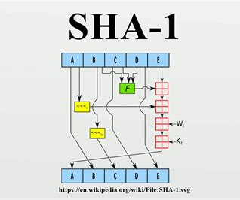
Architecture of SHA1 Operation Blocks
This is the architecture of the SHA1 core algorithm as a visual aid for all the previous steps.
Figure 2. Architecture of SHA1 Operation Blocks

Slide 9
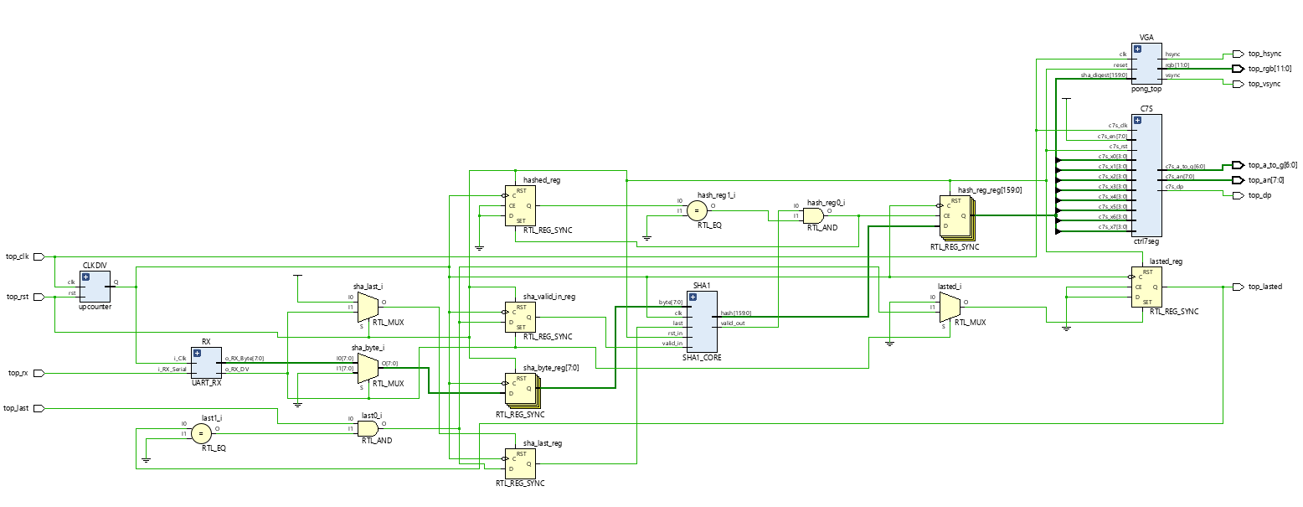
Implementation
7-Segment Dissplay
VGA communication Portocol
SHA-1 Core
UART Communication protocol
Clock divider component
Figure 3. Schematic of the implemented design of SHA1 Algorithm

Slide 10
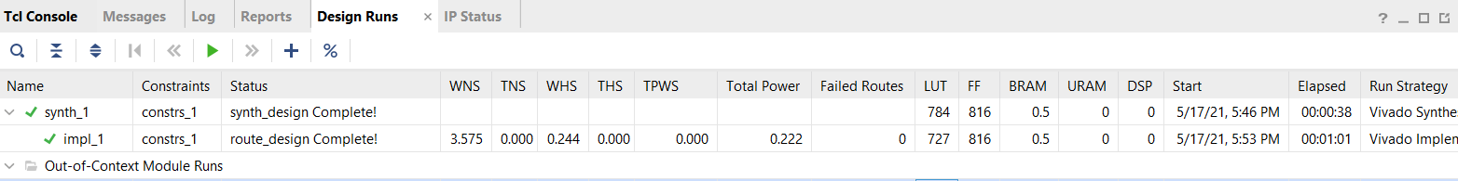
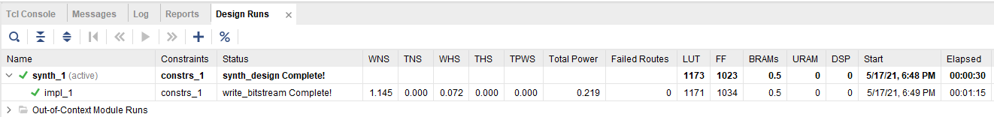
Results and Analysis
Figure 4. Screenshot of SHA-1 proposed design implementation results
Figure 5. Screenshot of SHA-1 [10] results

Slide 11
Comparison
The integration of byte to word conversion circuit and specialization of performing SHA1 may contribute to the reduced LUTs and Flip-Flops used in this design comparing to a multifunctional design.
There is room for improvement on power consumption for this design.
As W_{t} are generated by a combinational circuit, a possible improvement is to limit transition of signal on that logic to reduce power consumption, either by converting it to a sequential circuit or mask the activity of the circuit with an enable signal possibly from states signals to reduce signal transitions during idle states.
Algorithm | Power Consumption | LUT used | Flip Flops
[10] | 0.219 | 1171 | 1034
Proposed Design | 0.222 | 727 | 816
Table 2. Comparing Results of SHA-1 Implementations

Slide 12
Conclusion
A hardware SHA1 digest core designed to reduce power consumption and resource usage was successfully implemented at register-transfer level by integrating byte to word conversion circuitry and eliminating usage of division circuit by separating message schedule counter into a 2-bit and 5-bit counters. A companion system was designed and implemented to handle serial byte stream message input via UART and output the resulting SHA1 digest to a VGA display. Future work includes further reduction of power consumption possibly by reducing idle state signal transitions.

Slide 13

Demonstration:
Here is the link for our demonstration:
https://youtu.be/TPyGIwrq_no

